Slide 1
FLOW CONTROL

Slide 2
Flow control in computer networks is defined as the process of managing the rate of data transmission between two systems(nodes), this mechanism ensures that the rate of data (transmitted by the sender) is within the receiving capacity of the receiver node.

Slide 3
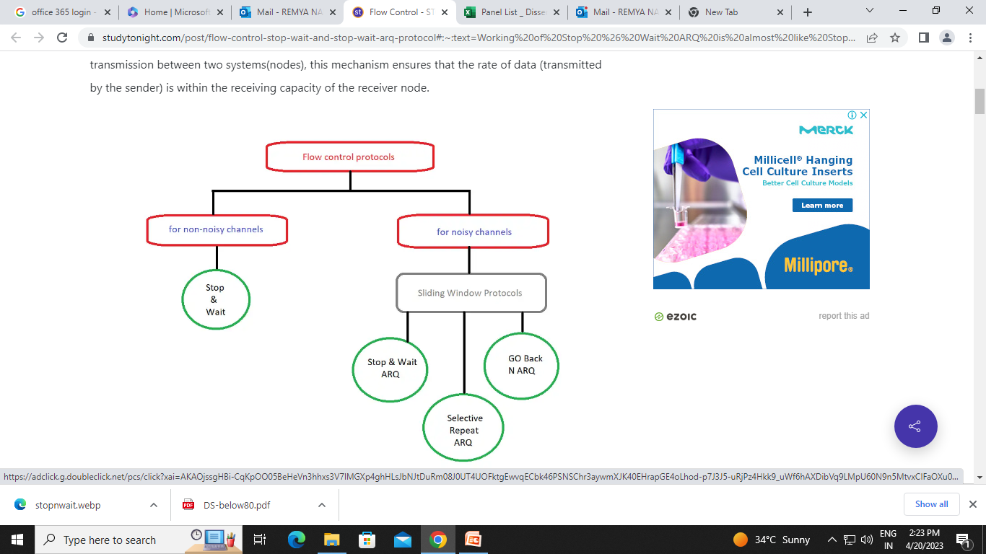

Slide 4
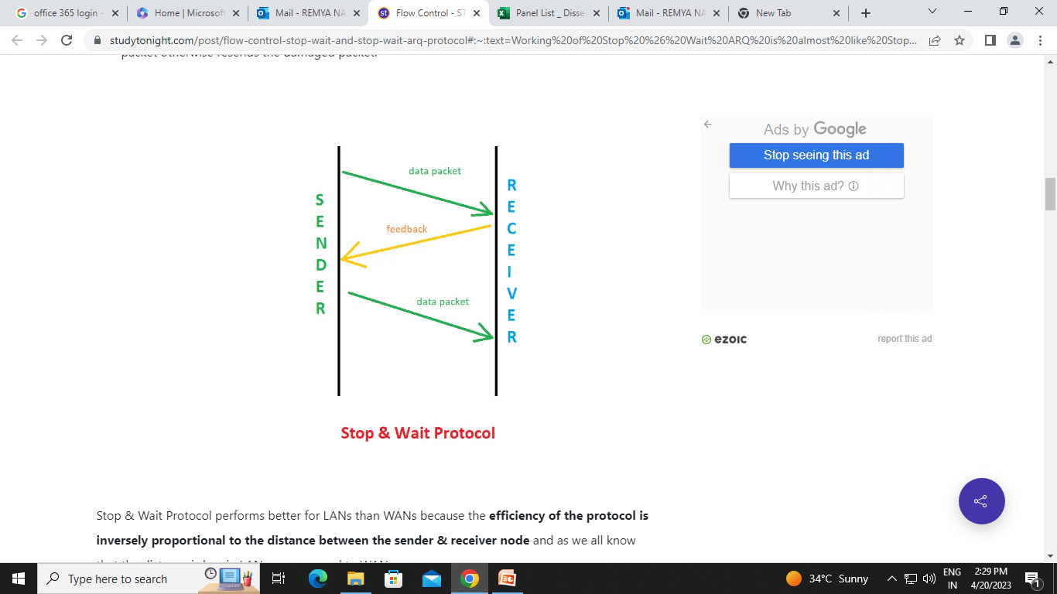

Slide 5
Flow Control
Flow control coordinates the amount of data that can be sent before receiving acknowledgement
It is one of the most important functions of data link layer.
Flow control is a set of procedures that tells the sender how much data it can transmit before it must wait for an acknowledgement from the receiver.
Receiver has a limited speed at which it can process incoming data and a limited amount of memory in which to store incoming data.
Receiver must inform the sender before the limits are reached and request that the transmitter to send fewer frames or stop temporarily.
Since the rate of processing is often slower than the rate of transmission, receiver has a block of memory (buffer) for storing incoming data until they are processed.

Slide 6
Flow Control Mechanisms
Stop-and-Wait
Sliding Window Protocol
Go-Back-N ARQ
Selective-Repeat ARQ

Slide 7
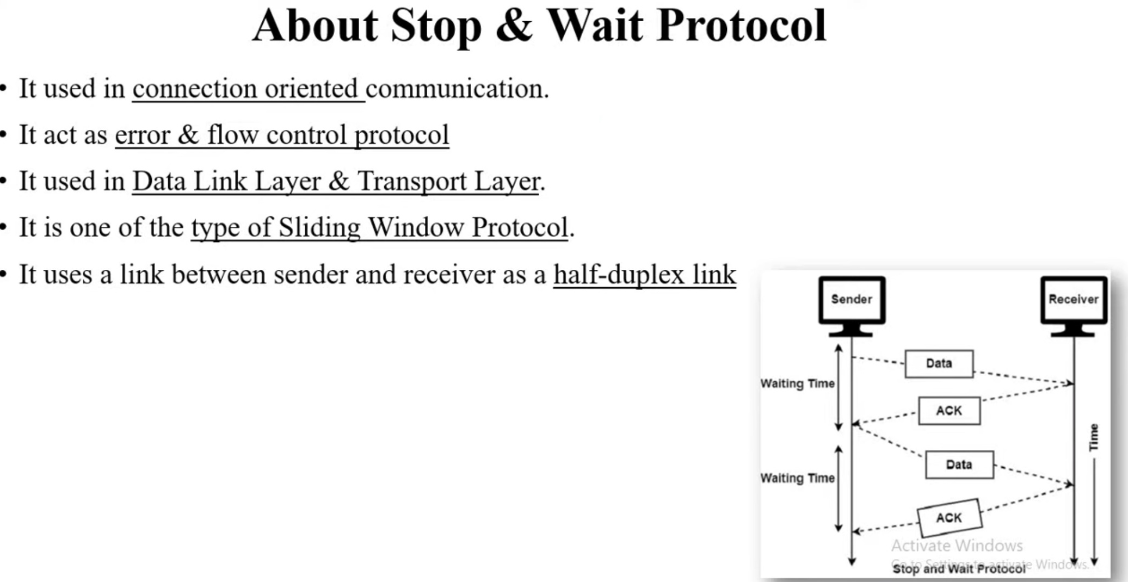

Slide 8
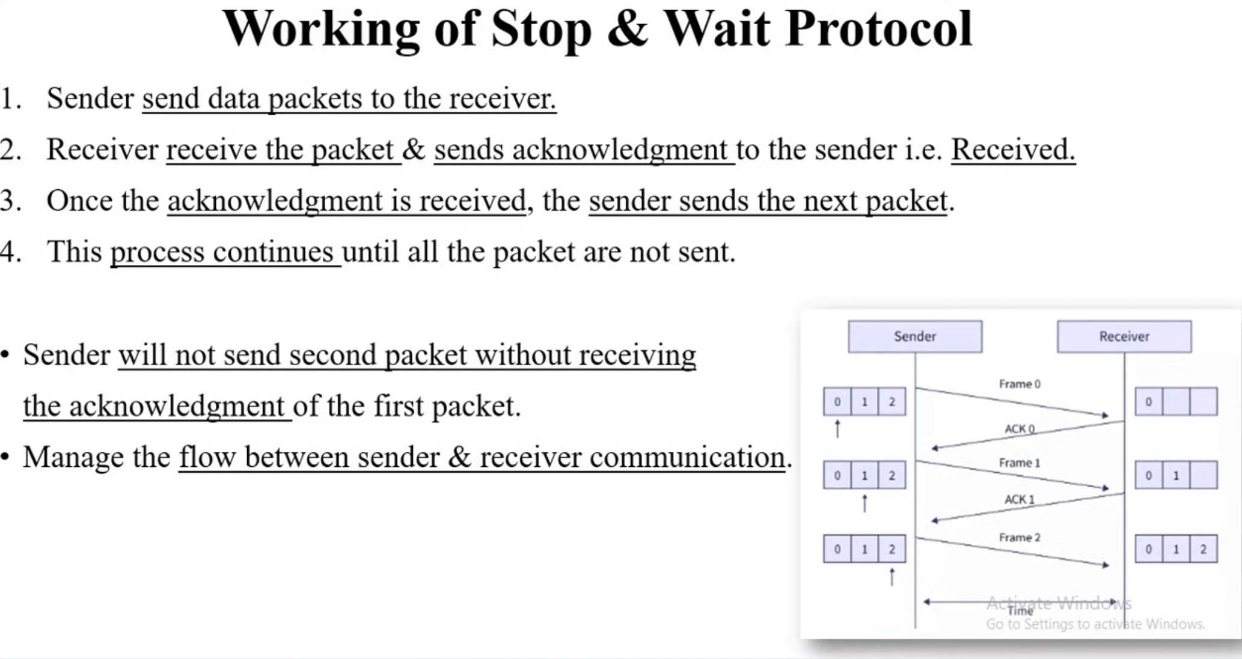

Slide 9
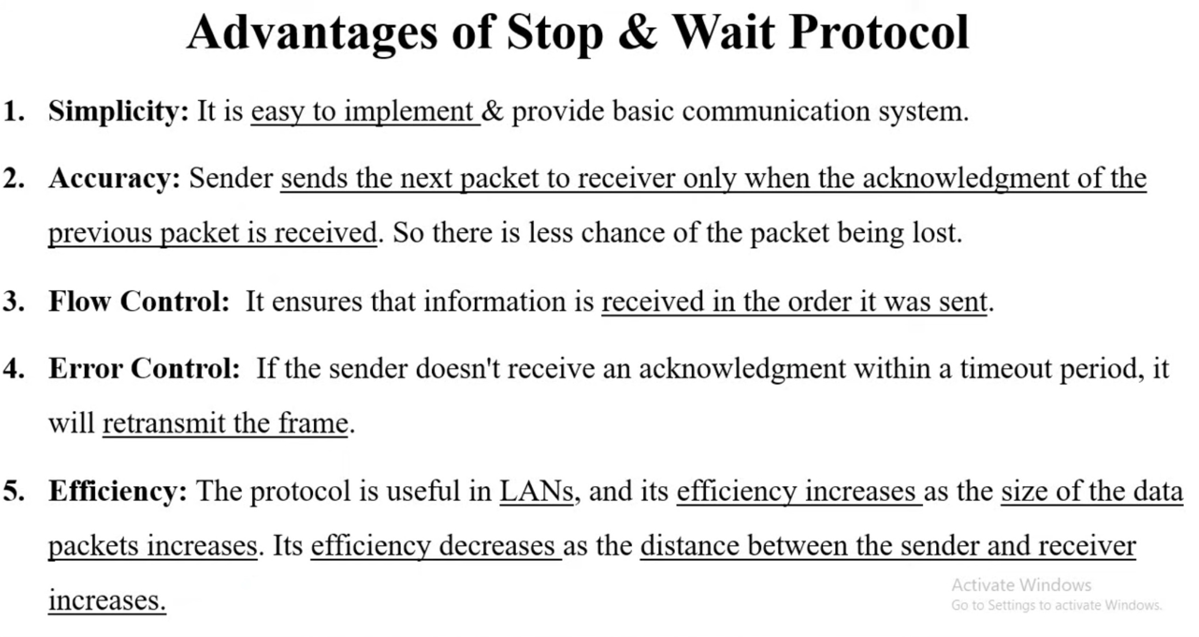

Slide 10
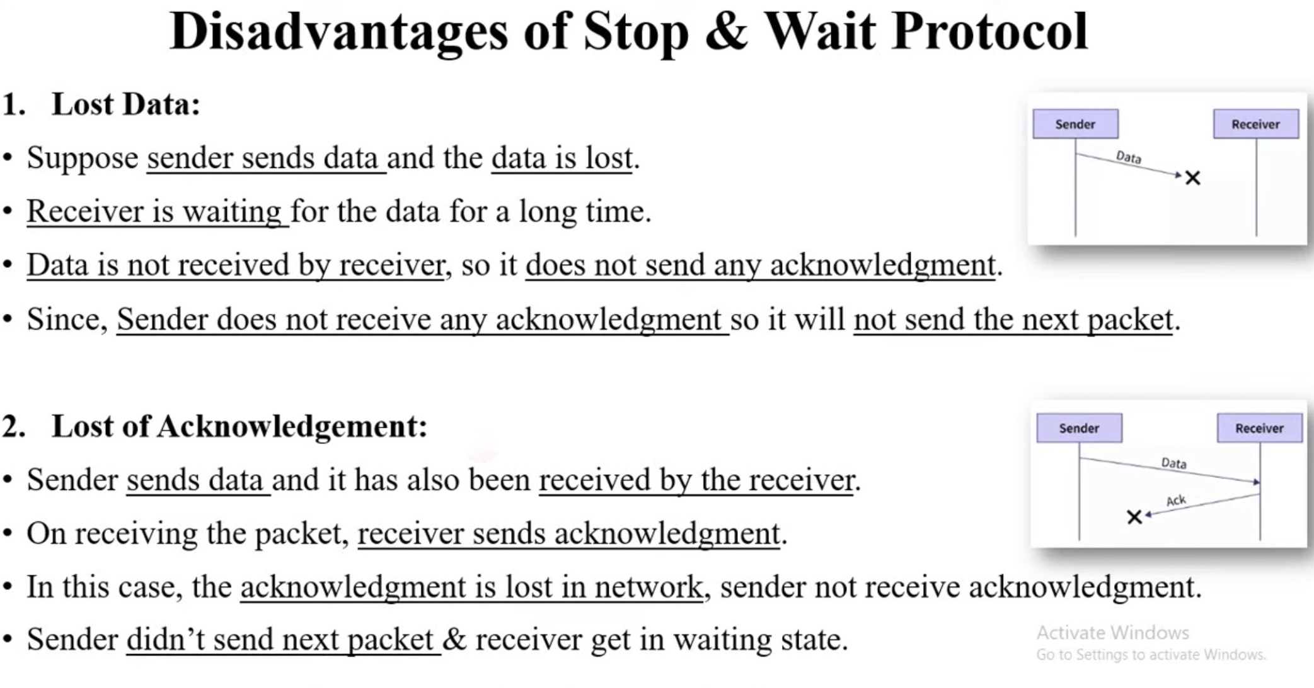

Slide 11
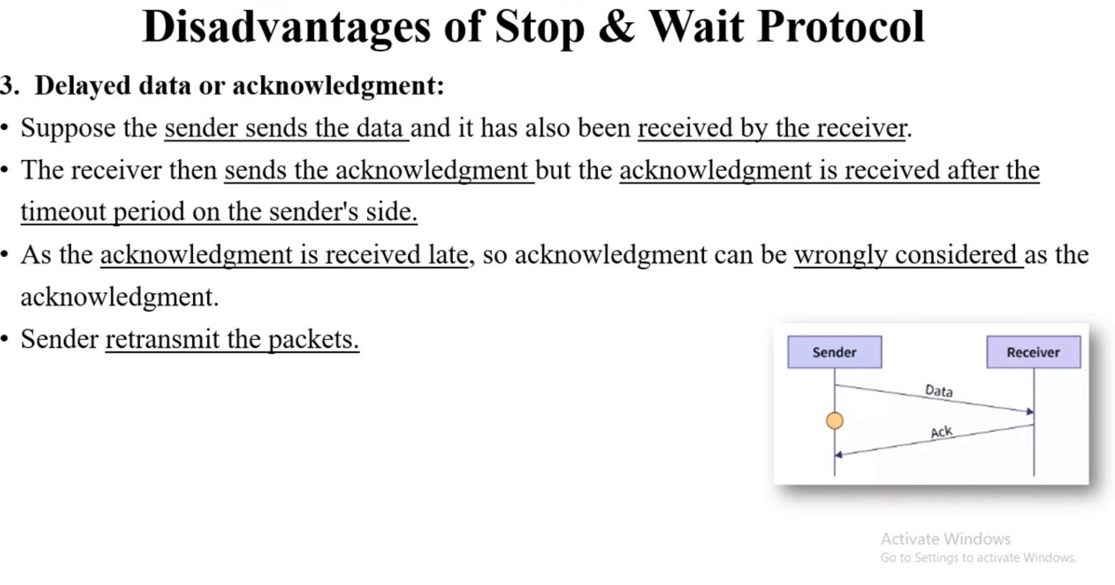

Slide 12
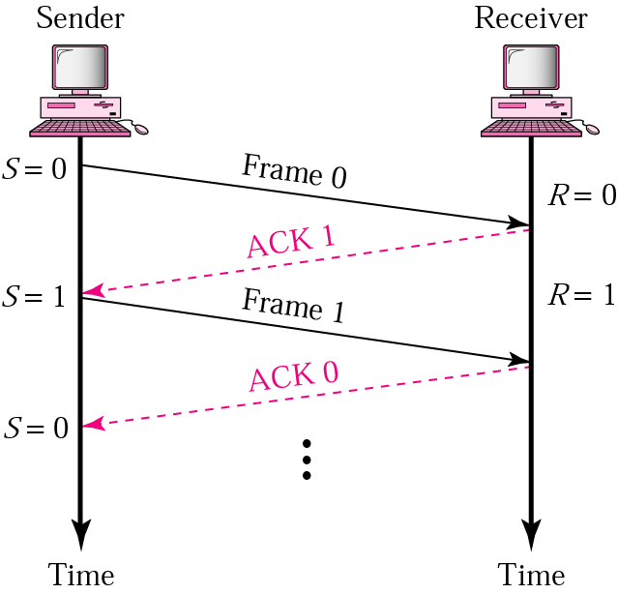
Stop-and-Wait
Sender keeps a copy of the last frame until it receives an acknowledgement.
For identification, both data frames and acknowledgements (ACK) frames are numbered alternatively 0 and 1.
Sender has a control variable (S) that holds the number of the recently sent frame. (0 or 1)
Receiver has a control variable ® that holds the number of the next frame expected (0 or 1).
Sender starts a timer when it sends a frame. If an ACK is not received within a allocated time period, the sender assumes that the frame was lost or damaged and resends it
Receiver send only positive ACK if the frame is intact.
ACK number always defines the number of the next expected frame

Slide 13
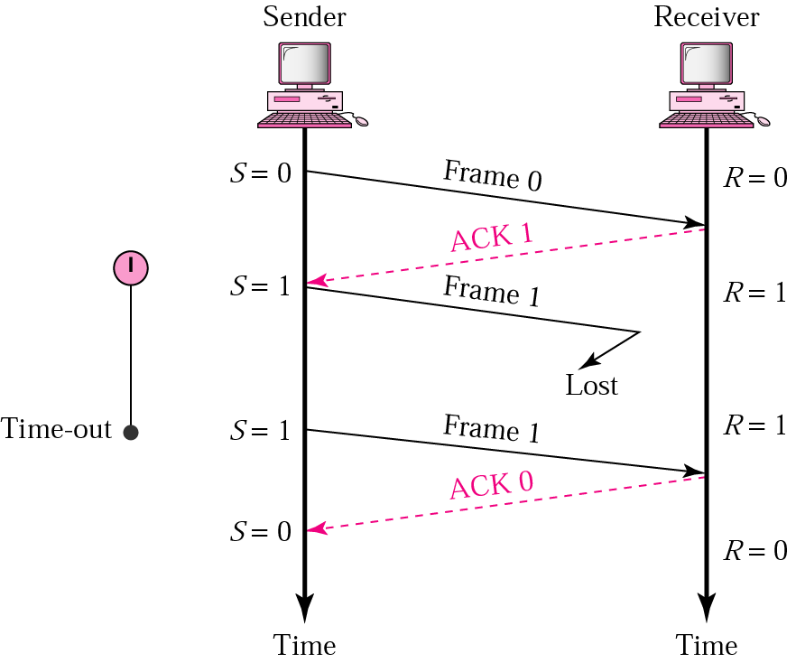
Stop-and-Wait ARQ, lost frame
When a receiver receives a damaged frame, it discards it and keeps its value of R.
After the timer at the sender expires, another copy of frame 1 is sent.

Slide 14
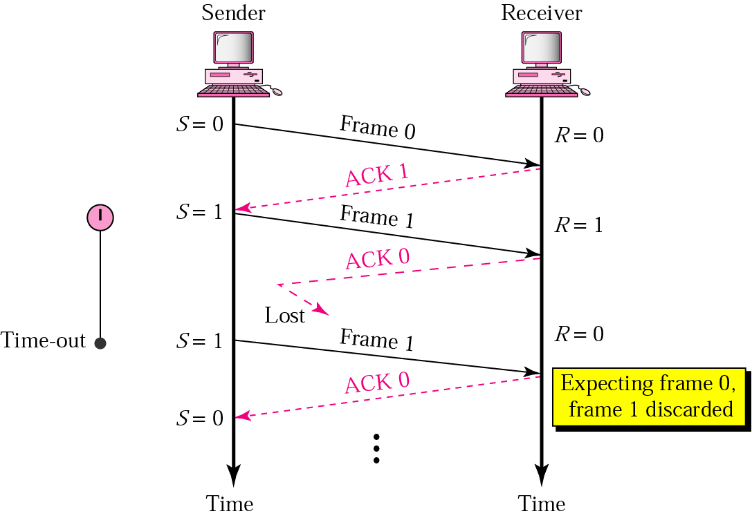
Stop-and-Wait, lost ACK frame
If the sender receives a damaged ACK, it discards it.
When the timer of the sender expires, the sender retransmits frame 1.
Receiver has already received frame 1 and expecting to receive frame 0 (R=0). Therefore it discards the second copy of frame 1.

Slide 15
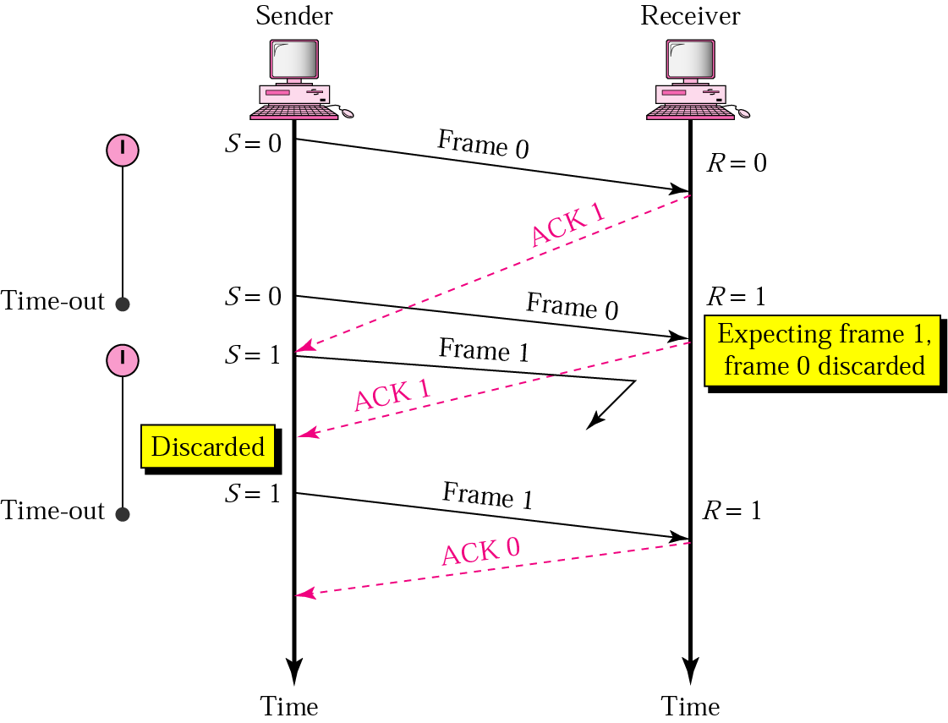
Stop-and-Wait, delayed ACK frame
The ACK can be delayed at the receiver or due to some problem
It is received after the timer for frame 0 has expired.
Sender retransmitted a copy of frame 0. However, R =1 means receiver expects to see frame 1. Receiver discards the duplicate frame 0.
Sender receives 2 ACKs, it discards the second ACK.

Slide 16
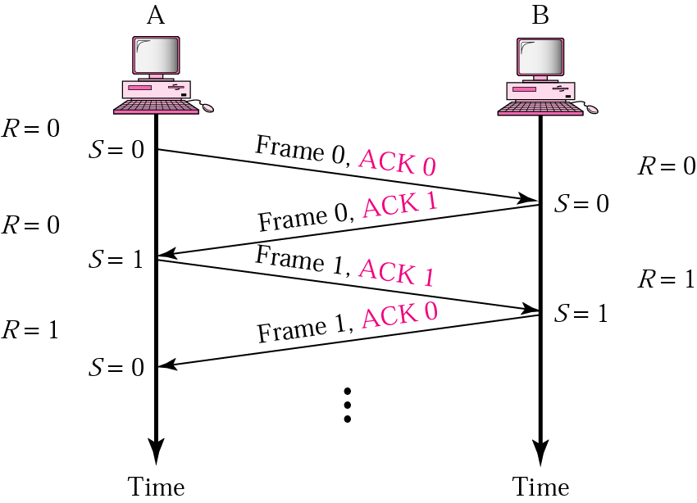
Piggybacking
A method to combine a data frame with ACK.
Station A and B both have data to send.
Instead of sending separately, station A sends a data frame that includes an ACK.
Station B does the same thing.
Piggybacking saves bandwidth.

Slide 17
Disadvantage of Stop-and-Wait
In stop-and-wait, at any point in time, there is only one frame that is sent and waiting to be acknowledged.
This is not a good use of transmission medium.
To improve efficiency, multiple frames should be in transition while waiting for ACK.
Two protocol use the above concept,
Go-Back-N ARQ
Selective Repeat ARQ

Slide 18
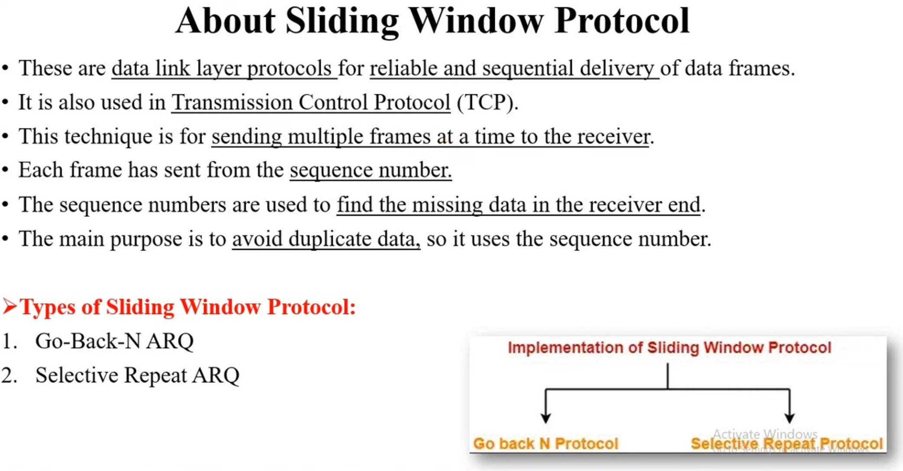

Slide 19
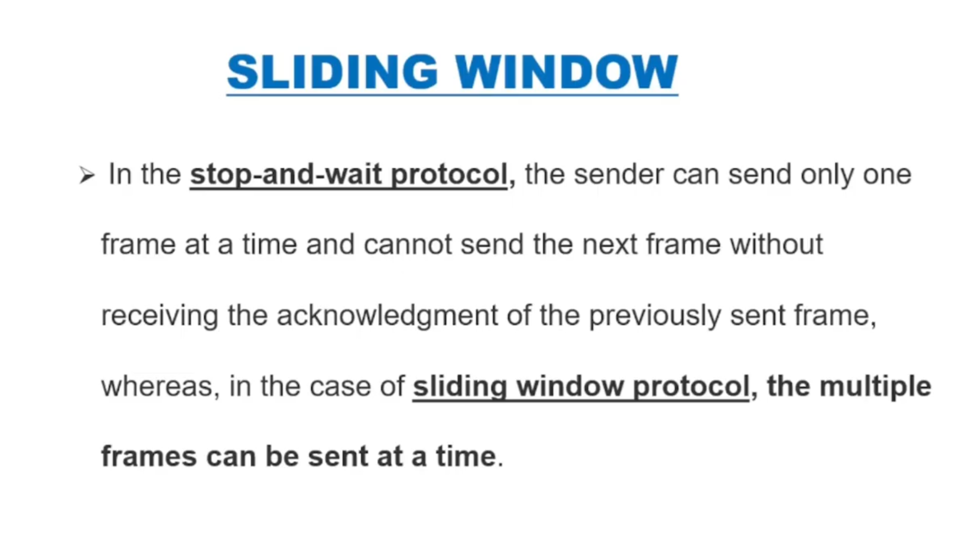

Slide 20
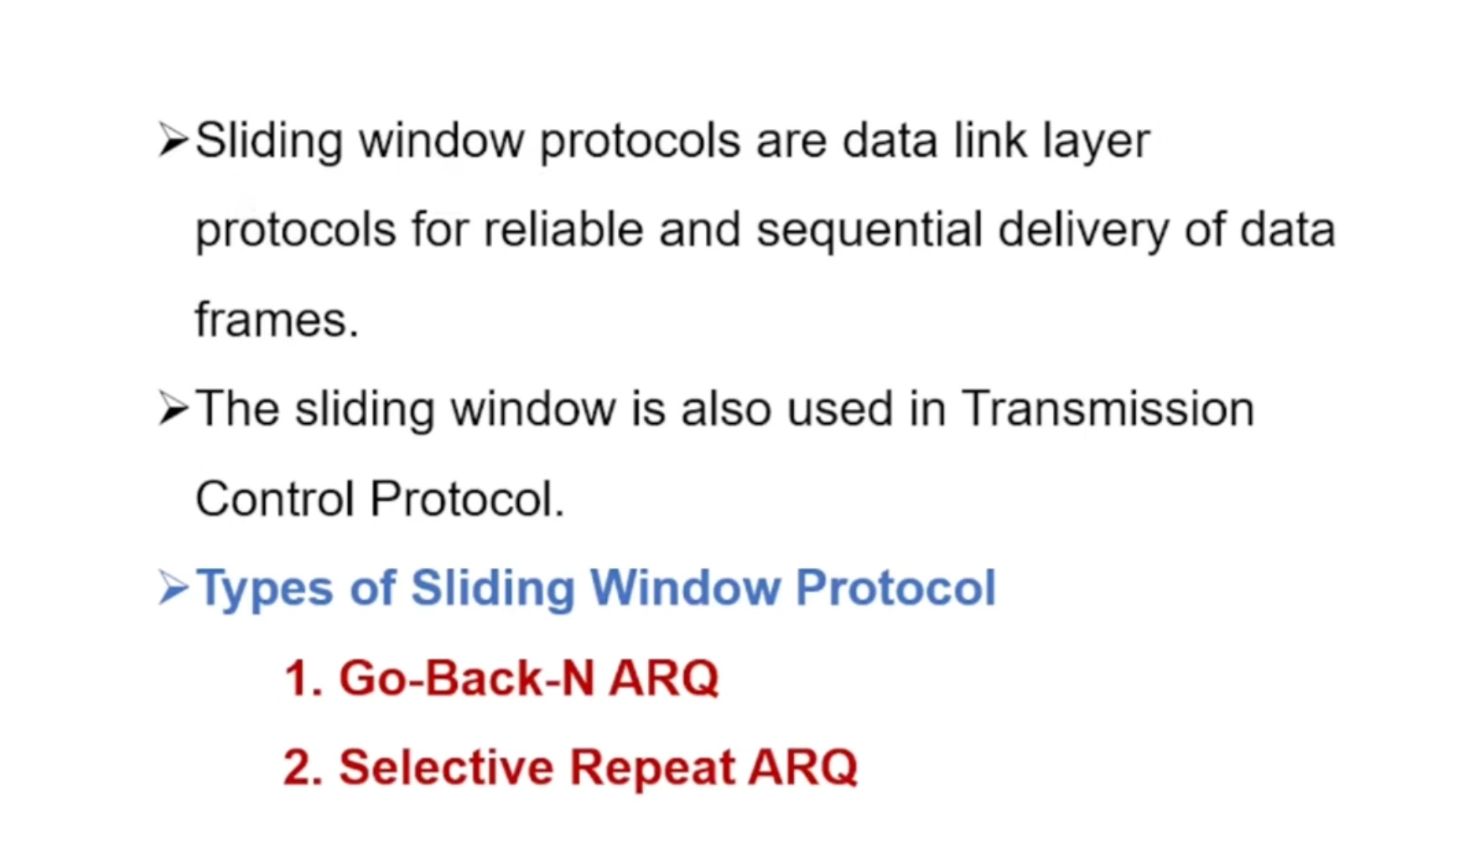

Slide 21
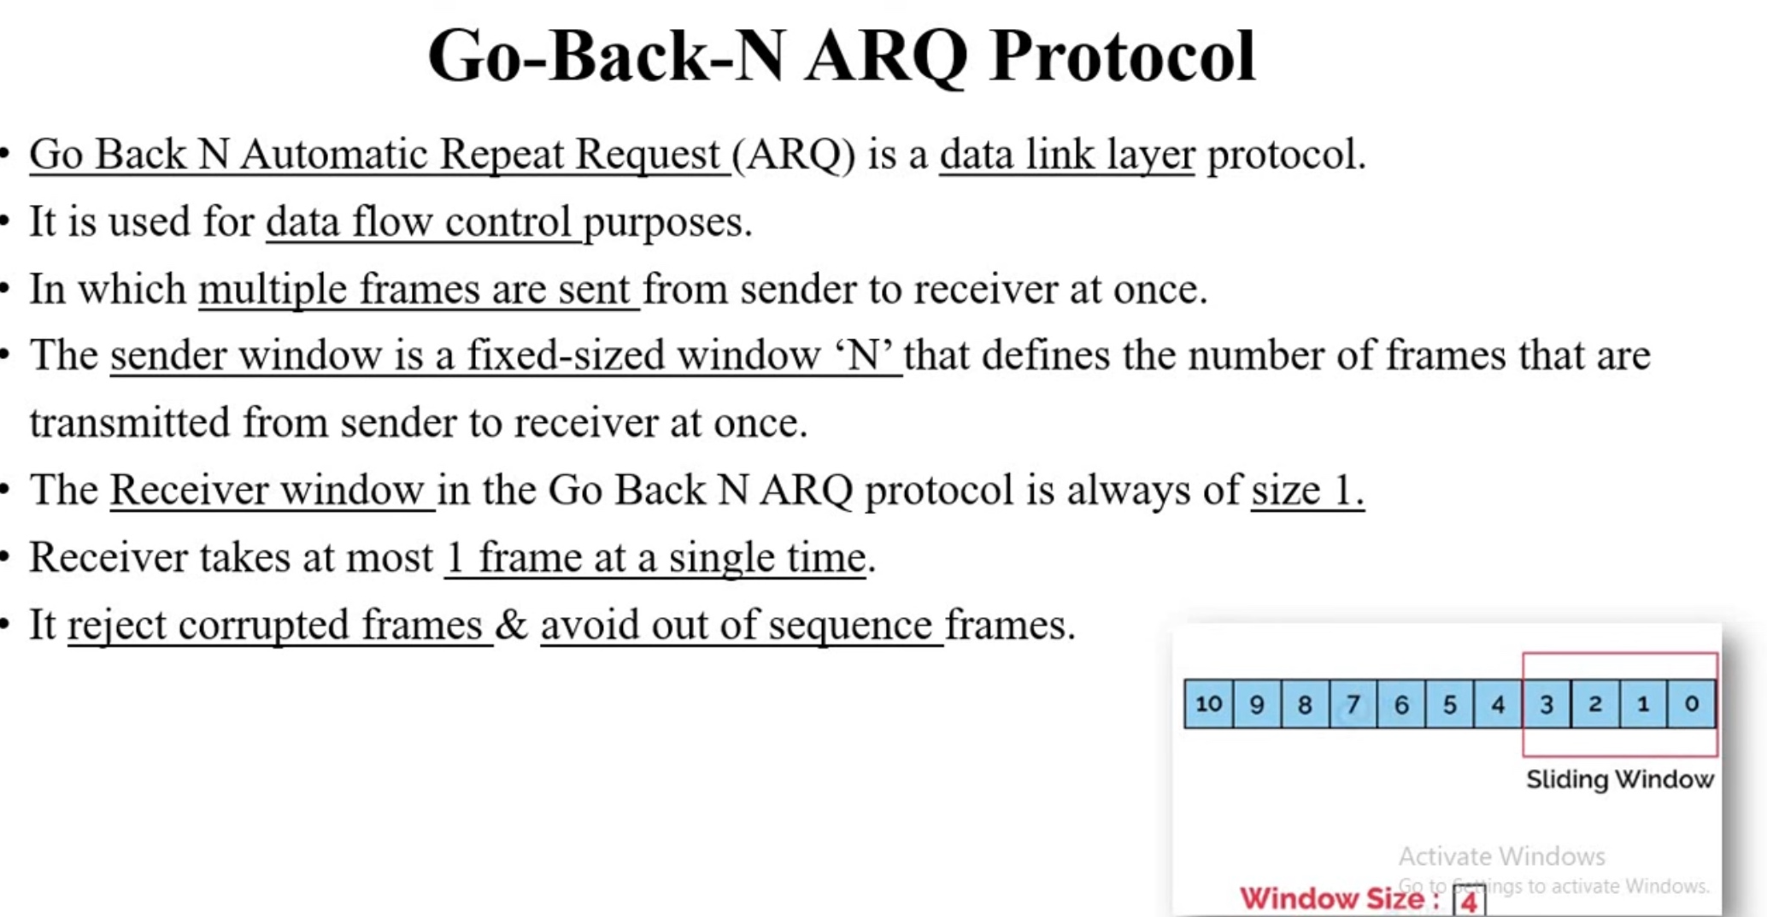

Slide 22
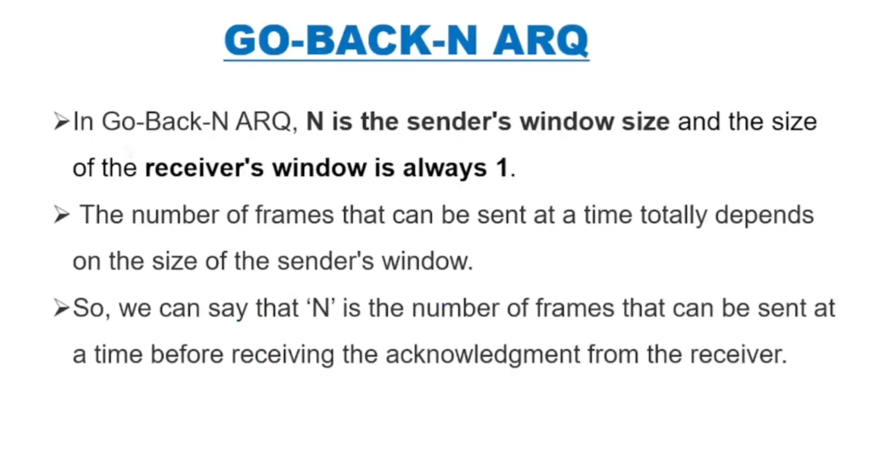

Slide 23
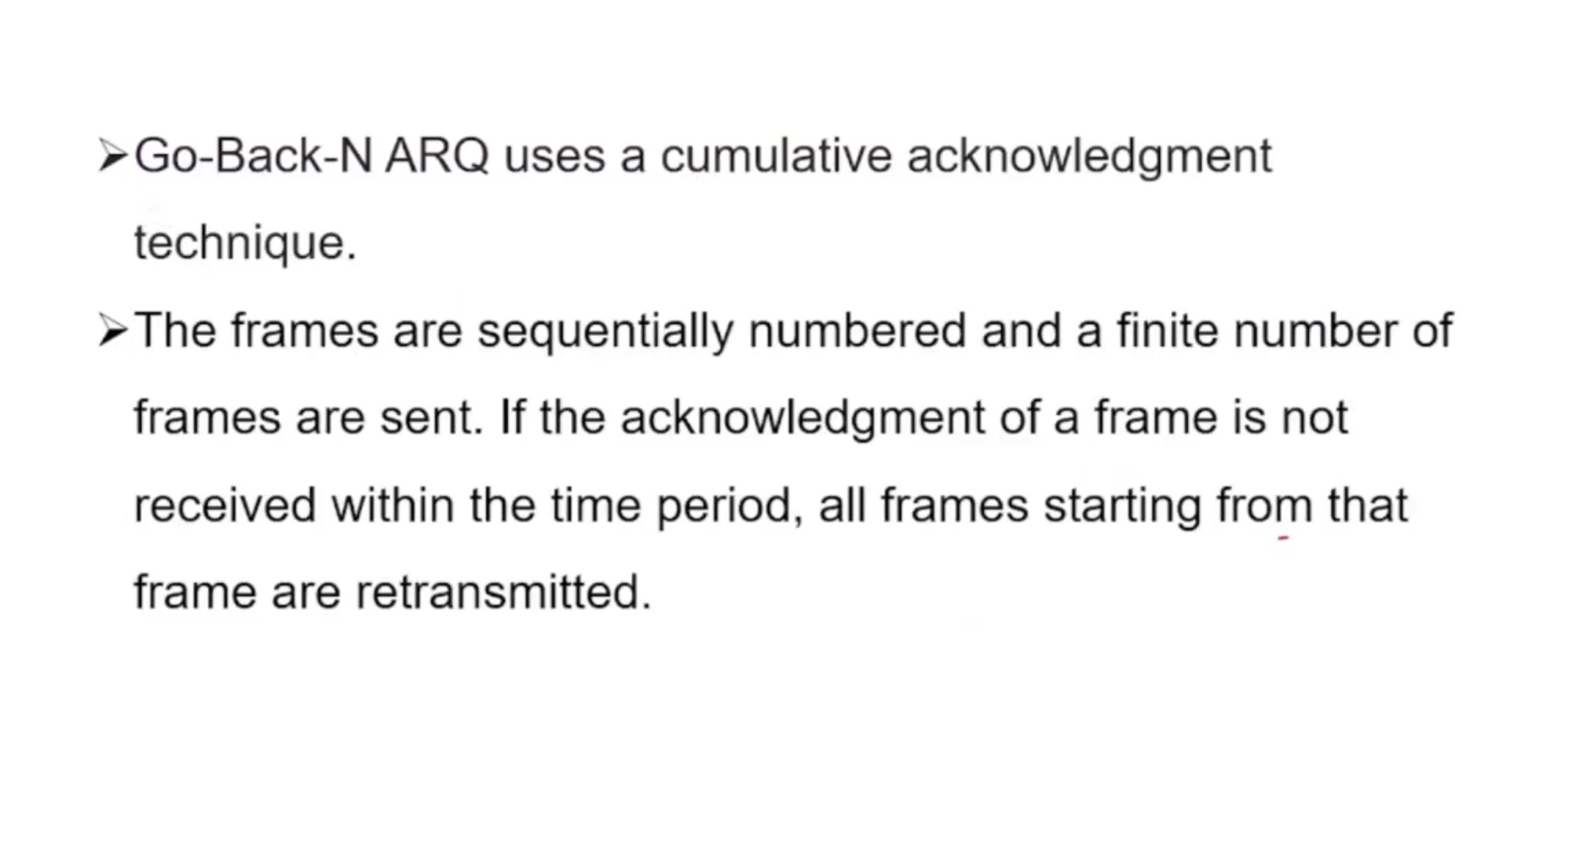

Slide 24
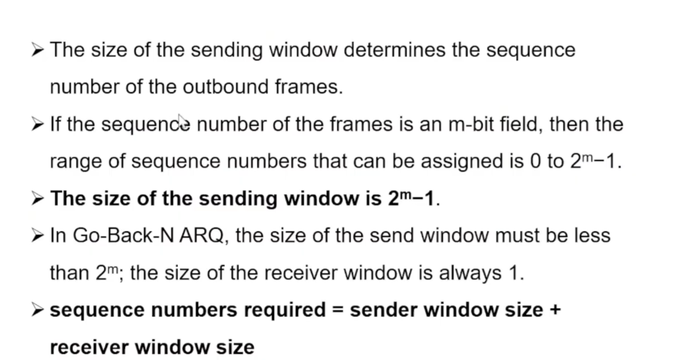

Slide 25
Go-Back-N ARQ
We can send up to W frames before worrying about ACKs.
We keep a copy of these frames until the ACKs arrive.
This procedure requires additional features to be added to Stop-and-Wait ARQ.

Slide 26
Sequence Numbers
Frames from a sender are numbered sequentially.
We need to set a limit since we need to include the sequence number of each frame in the header.
If the header of the frame allows m bits for sequence number, the sequence numbers range from 0 to 2 ^{m} – 1. for m = 3, sequence numbers are: 1, 2, 3, 4, 5, 6, 7.
We can repeat the sequence number.
Sequence numbers are:
0, 1, 2, 3, 4, 5, 6, 7, 0, 1, 2, 3, 4, 5, 6, 7, 0, 1, …

Slide 27
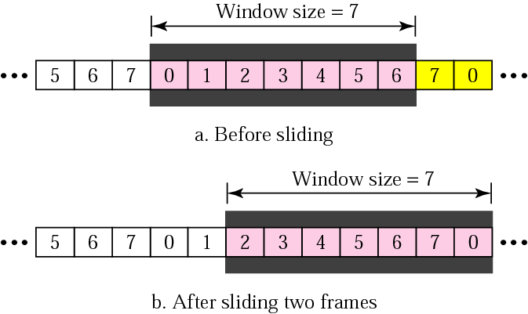
Sender Sliding Window
At the sending site, to hold the outstanding frames until they are acknowledged, we use the concept of a window.
The size of the window is at most 2^{m} -1 where m is the number of bits for the sequence number.
Size of the window can be variable, e.g. TCP.
The window slides to include new unsent frames when the correct ACKs are received

Slide 28
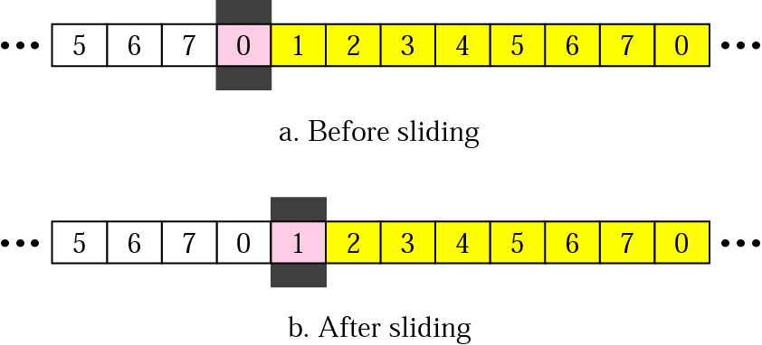
Receiver Sliding Window
Size of the window at the receiving site is always 1 in this protocol.
Receiver is always looking for a specific frame to arrive in a specific order.
Any frame arriving out of order is discarded and needs to be resent.
Receiver window slides as shown in fig. Receiver is waiting for frame 0 in part a.

Slide 29
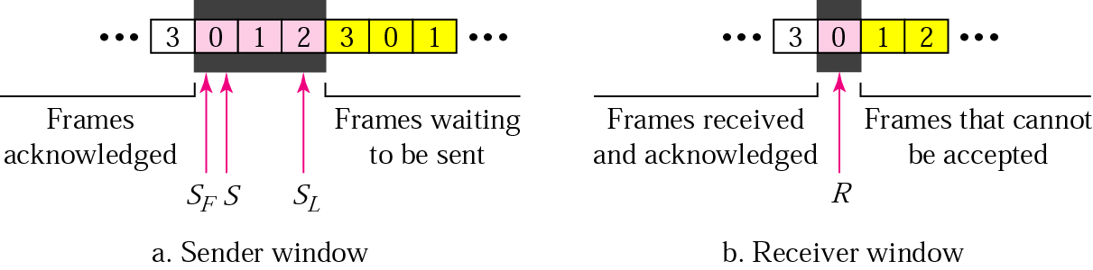
Control Variables
Sender has 3 variables: S, S_{F}, and S_{L}
S holds the sequence number of recently sent frame
S_{F} holds the sequence number of the first frame
S_{L} holds the sequence number of the last frame
Receiver only has the one variable, R, that holds the sequence number of the frame it expects to receive. If the seq. no. is the same as the value of R, the frame is accepted, otherwise rejected.

Slide 30
Acknowledgement
Receiver sends positive ACK if a frame arrived safe and in order.
If the frames are damaged/out of order, receiver is silent and discard all subsequent frames until it receives the one it is expecting.
The silence of the receiver causes the timer of the unacknowledged frame to expire.
Then the sender resends all frames, beginning with the one with the expired timer.
For example, suppose the sender has sent frame 6, but the timer for frame 3 expires (i.e. frame 3 has not been acknowledged), then the sender goes back and sends frames 3, 4, 5, 6 again. Thus it is called Go-Back-N-ARQ
The receiver does not have to acknowledge each frame received, it can send one cumulative ACK for several frames.

Slide 31
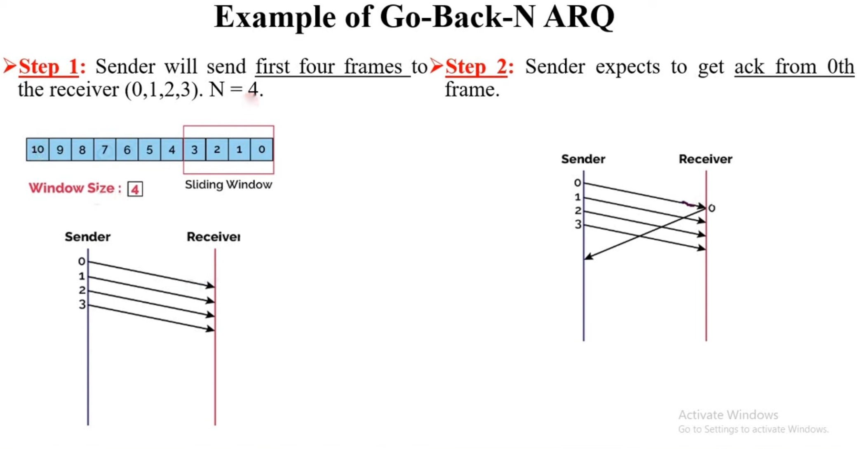

Slide 32
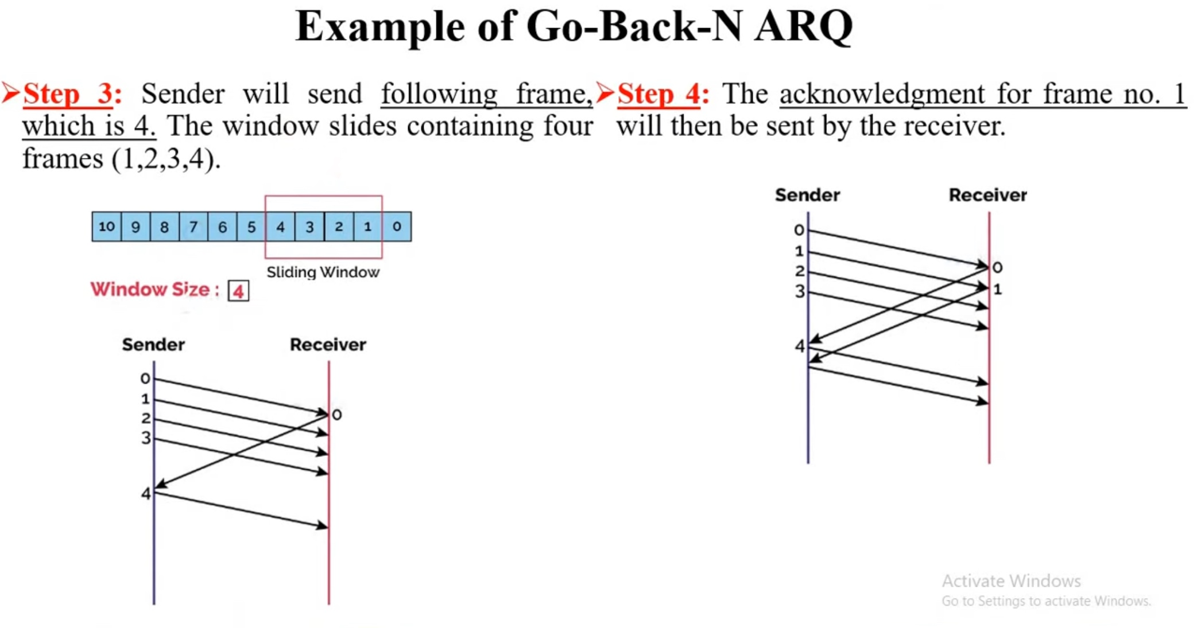

Slide 33
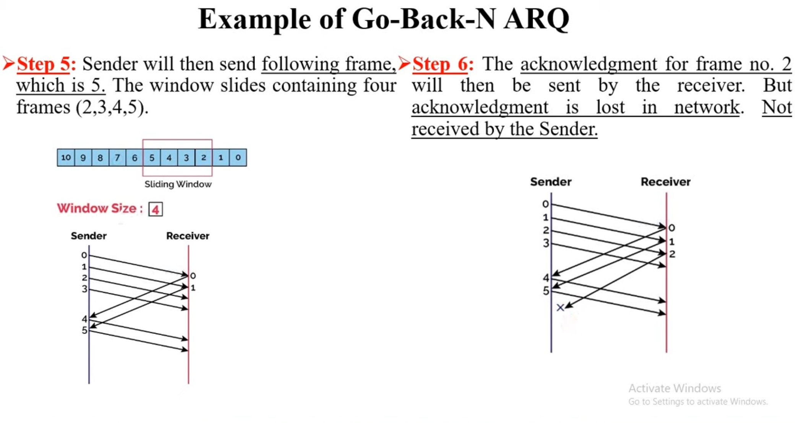

Slide 34
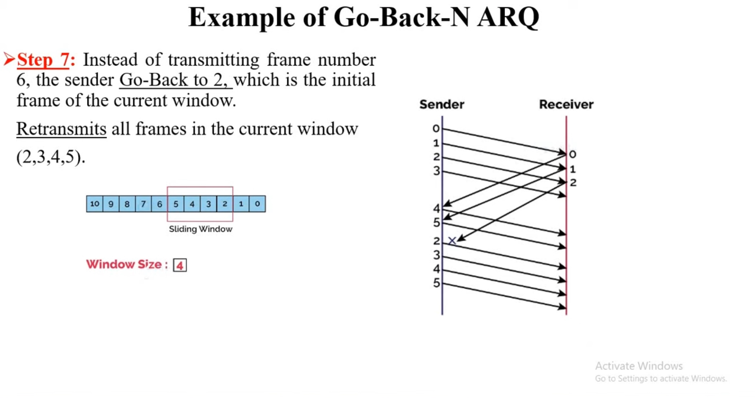

Slide 35
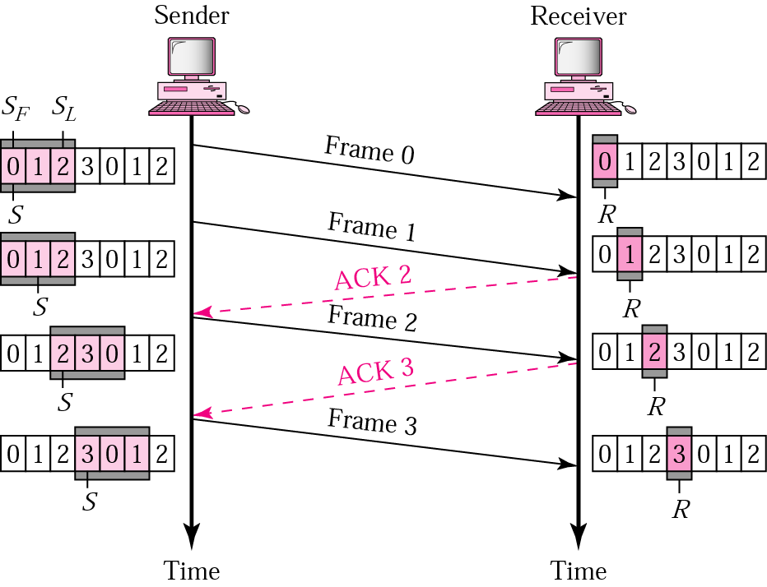
Go-Back-N ARQ, normal operation
The sender keeps track of the outstanding frames and updates the variables and windows as the ACKs arrive.

Slide 36
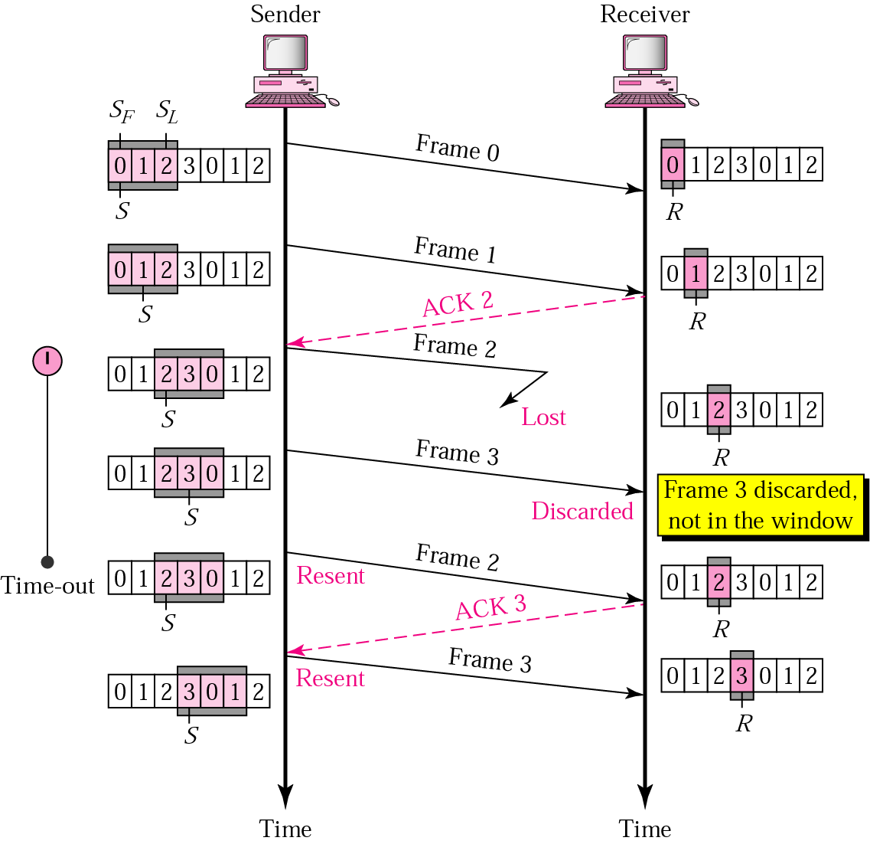
Go-Back-N ARQ, lost frame
Frame 2 is lost
When the receiver receives frame 3, it discards frame 3 as it is expecting frame 2 (according to window).
After the timer for frame 2 expires at the sender site, the sender sends frame 2 and 3. (go back to 2)

Slide 37
Go-Back-N ARQ, damaged/lost/delayed ACK
If an ACK is damaged/lost, we can have two situations:
If the next ACK arrives before the expiration of any timer, there is no need for retransmission of frames because ACKs are cumulative in this protocol.
If ACK1, ACK2, and ACk3 are lost, ACK4 covers them if it arrives before the timer expires.
If ACK4 arrives after time-out, the last frame and all the frames after that are resent.
Receiver never resends an ACK.
A delayed ACK also triggers the resending of frames

Slide 38
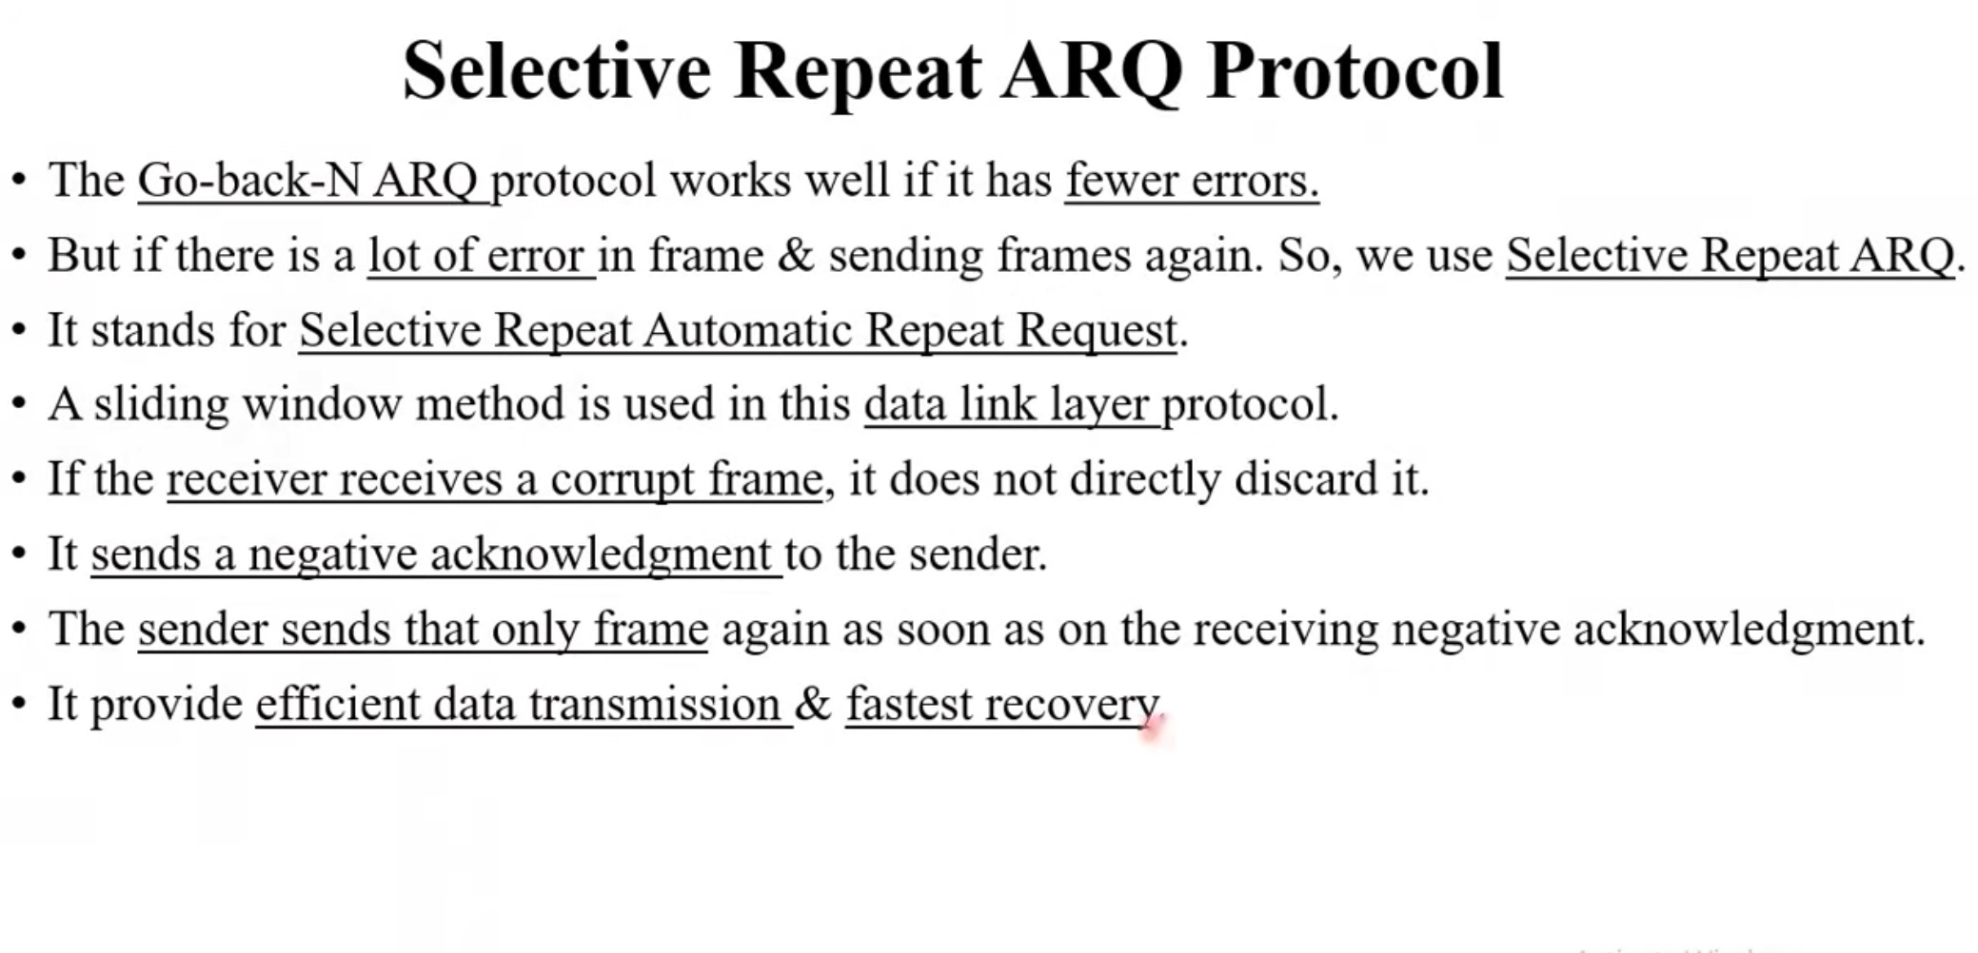

Slide 39
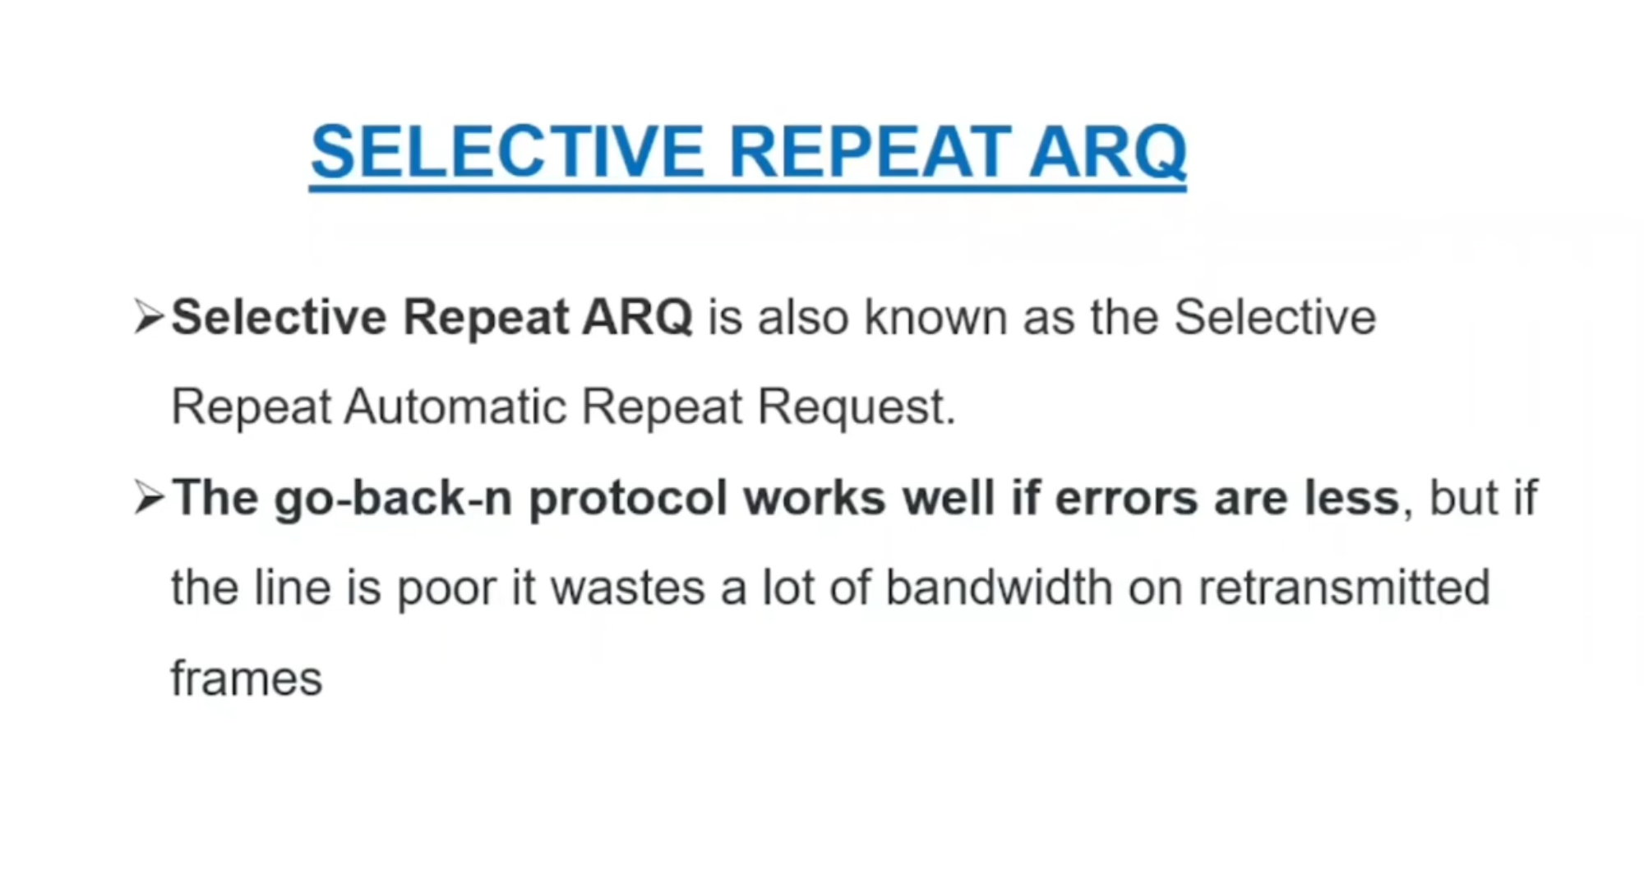

Slide 40
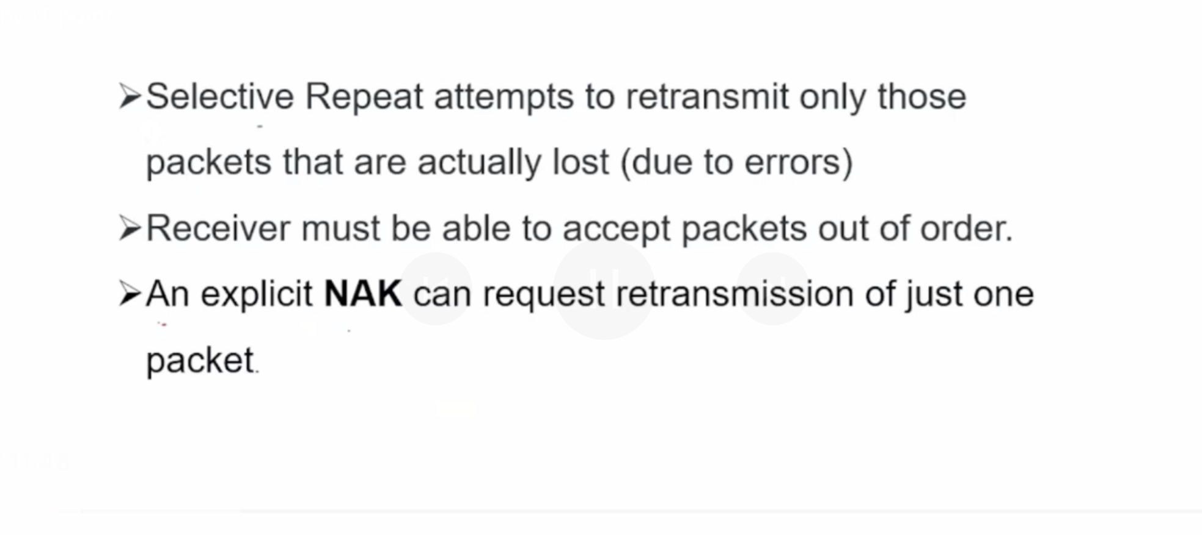

Slide 41
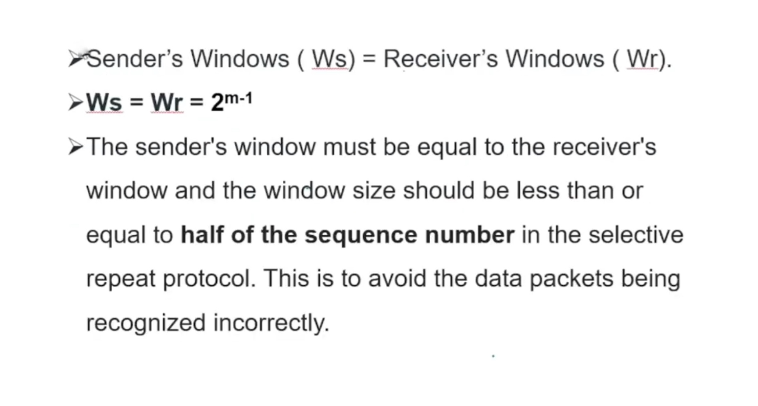

Slide 42
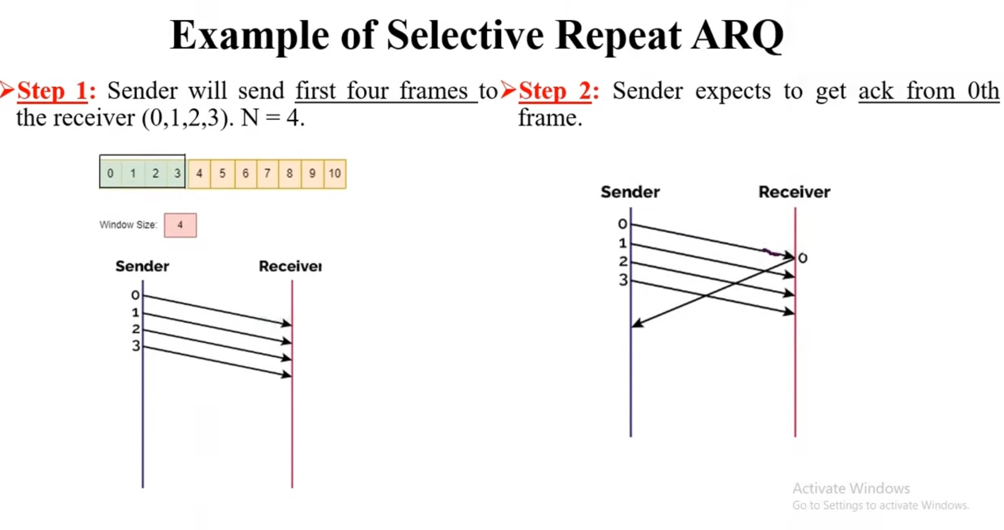

Slide 43
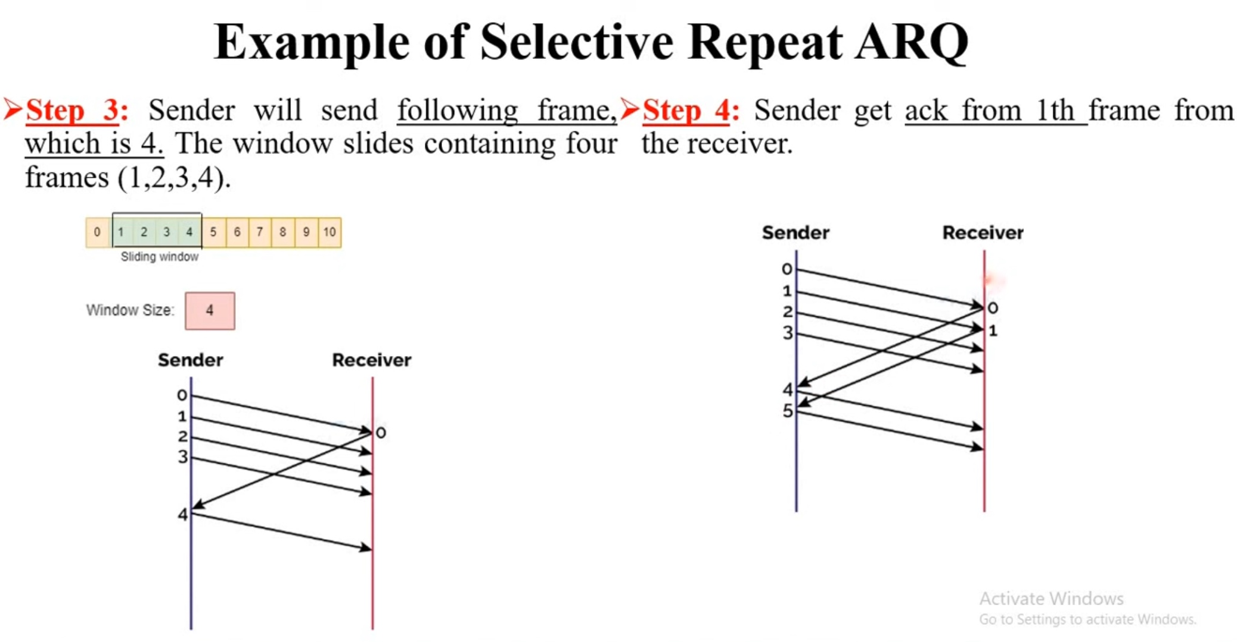

Slide 44
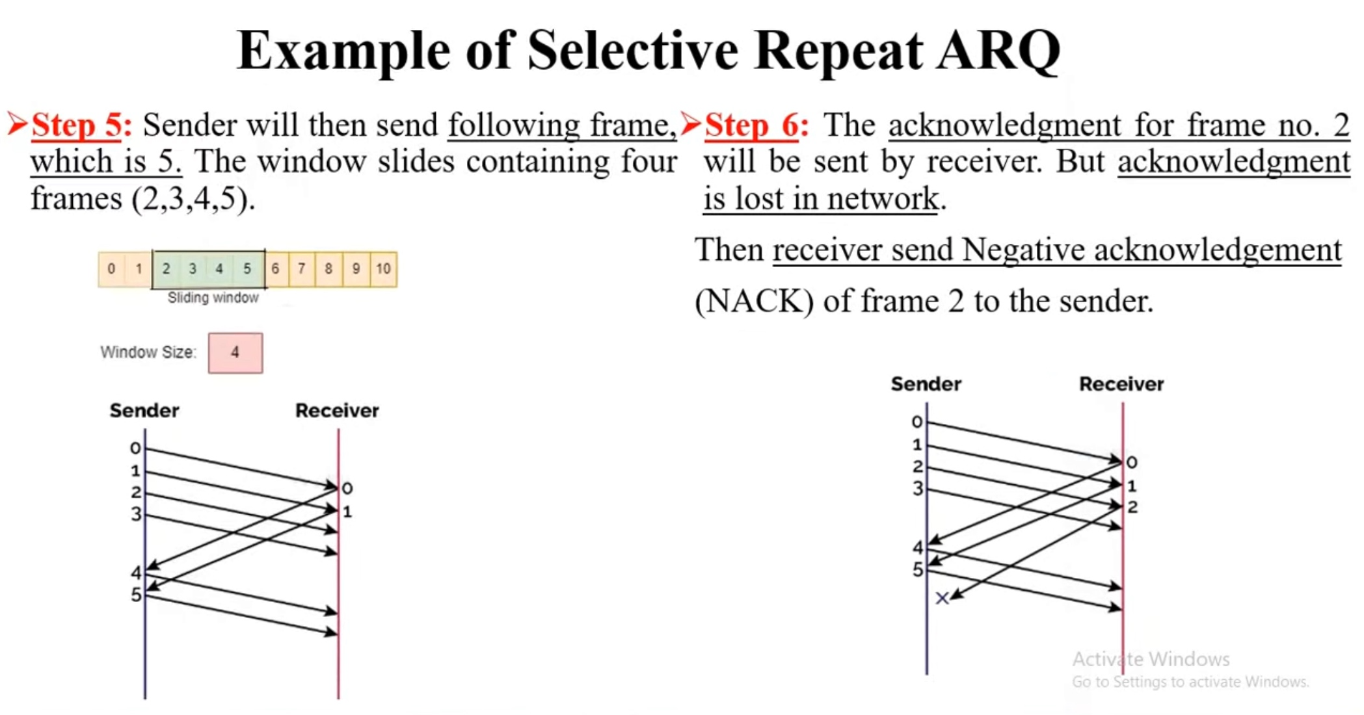

Slide 45
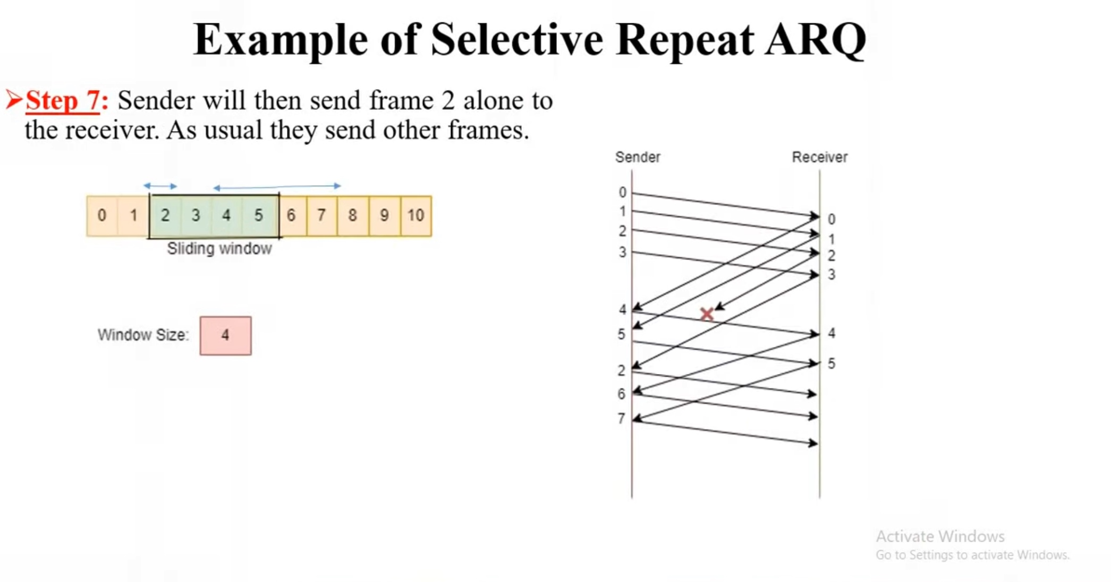

Slide 46
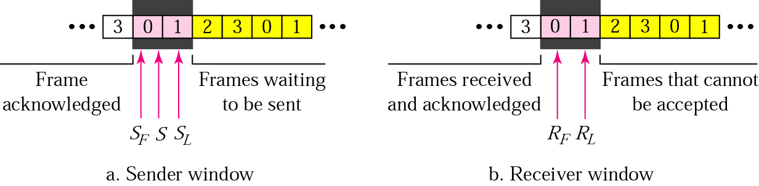
Selective Repeat ARQ, sender and receiver windows
Go-Back-N ARQ simplifies the process at the receiver site. Receiver only keeps track of only one variable, and there is no need to buffer out-of-order frames, they are simply discarded.
However, Go-Back-N ARQ protocol is inefficient for noisy link. It bandwidth inefficient and slows down the transmission.
In Selective Repeat ARQ, only the damaged frame is resent. More bandwidth efficient but more complex processing at receiver.
It defines a negative ACK (NAK) to report the sequence number of a damaged frame before the timer expires.

Slide 47
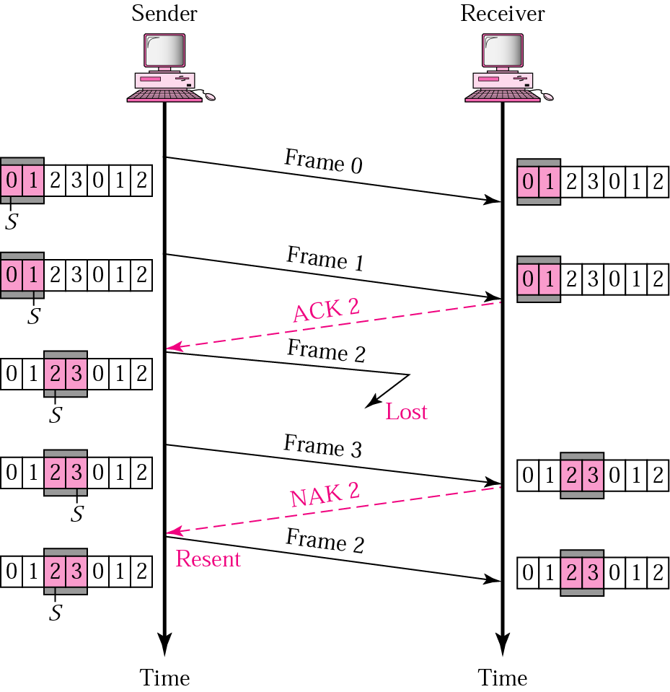
Selective Repeat ARQ, lost frame
Frames 0 and 1 are accepted when received because they are in the range specified by the receiver window. Same for frame 3.
Receiver sends a NAK2 to show that frame 2 has not been received and then sender resends only frame 2 and it is accepted as it is in the range of the window.

